Slide 1
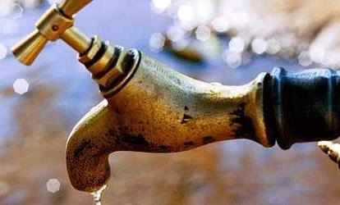
«Water Sector Reform in Kenya »
Trainings 24.-28.8. and 28.9.-2.10.2015

Slide 2
Introduction to Wastewater
Based in parts on DWA/Engicon „Introduction to Wastewater“, modified by Margraf Publishers

Slide 3
Table of Content
What is wastewater
Types of wastewater
Wastewater collection
Wastewater quality
Wastewater: importance and reasons for treatment

Slide 4
What is wastewater?
All types of wastewater emitted from various human activities (domestic, commercial, industrial)
sometimes called sewage or wastewater because they are often transported in the public sewage network

Slide 5
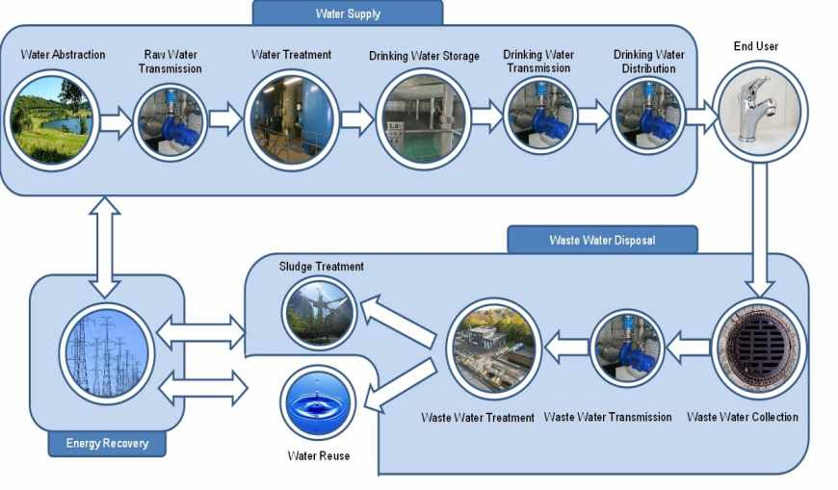
Water turns to wastewater

Slide 6
Types of wastewater (I)
There are two types of wastewater:
1- Domestic wastewater
The water resulting from human use in homes, bathrooms, kitchens, laundries and toilets, which may include industrial liquid waste discharges are allowed to sewage networks linking the public in accordance with instructions issued by the official authorities and receive home filtration plants operating in the country

Slide 7
Domestic wastewater: What products are we dealing with?
Introduction
Excreta: urine & faeces
Blackwater: urine, faeces & flush
Yellow-water:
separated urine
Greywater: wastewater from kitchen, bath, shower.
Faecal sludge: solids and liquids accumulating in sanitation systems
A sanitation system must manage all products generated !
Notes:
Key messages
Households produce different waste products.
A sanitation system must deal with all products generated.
Next slide: What are the characteristics of waste products?
Additional information & questions:
The generation of liquid waste from human activities is unavoidable. However, not all humans produce the same amount of liquid waste. The type and amount of liquid waste produced in households is influenced by behaviour, lifestyle and standard of living of the population as well as by the governing technical and juridical framework. (Henze and Ledin 2001, pp. 57-72)
The following section describes the different liquid waste fractions produced by the households. Industrial wastewater is not included, although it makes up an important fraction of wastewater in some environments. (Tilley 2007, pp. 2)
Blackwater is the mixture of urine, faeces and flushing water, along with anal cleansing water (if anal cleansing is practiced) or dry cleansing material (e.g. toilet paper).
Greywater is used water which results from bathing, hand-washing, cooking or clothes-washing. It is sometimes mixed with, or treated along with, other types of products
Urine is urine that is not mixed with any faeces or water.
Faeces refers to (semi) solid excrement without any urine or water.
Excreta is the mixture of urine and faeces that is not mixed with any flushing water (although small amounts of anal cleansing water may be included).
Faecal Sludge is the general term for the undigested, or partially digested slurry or solid that results from the storage or treatment of blackwater or excreta.
Why distinguish between so many products?

Slide 8
Types of wastewater
2- Industrial wastewater
The water resulting from the activity and industrial production are divided into two parts:
Industrial Wastewater connected to the sewage system and delivered to the wastewater treatment plants as wastewater mixed household wastewater.
Industrial wastewater not connected to the network and that is put into the environment in different ways such as rivers, streams and ocean or exploited for agricultural purposes.

Slide 9
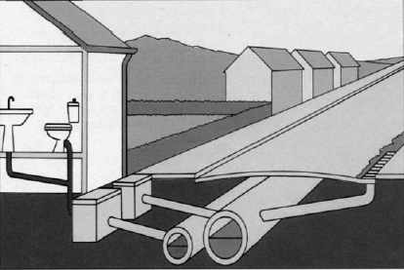
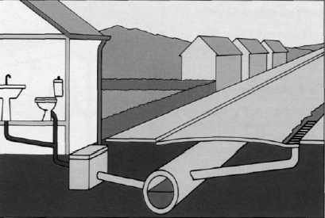
Wastewater collection networks
Sewerage network
The networks that collect household wastewater, industrial and commercial
Storm water network
The networks that discharge storm water and street wash water only
Combined system
The networks that conduct various types of water regardless of its source, household, industrial or rain water

Slide 10
What do we mean by quality?
When we talk about the quality of water, whether drinking water or wastewater,
we're talking about the properties of this water and
the extent of being complying with the national and international standards of the drinking water and wastewater quality.

Slide 11
The importance of wastewater (reuse)
Due to the scarcity of water resources,
increasing population, rising standard of living and
increased demand for agricultural and industrial water and economic development, trade and tourism,
the waste water is regarded as an important and strategic part of the water budget in many countries
where it is considered as an important source of water to be exploited in various areas.

Slide 12
Reasons for wastewater treatment
Protection of surface water and groundwater and the environment from pollution in general
Prevention of the spread of diseases and epidemics
Avoidance of the inconvenience and harassment of people
Re-use of water after treatment for various agricultural and industrial purposes

